Slide 1
Linux file systems

Slide 2
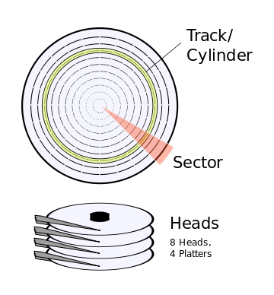
Layers of abstraction
On the hardware level, we talk about hard disks being divided up into tracks/cylinders, sectors, heads, etc
Traditionally, one sector is 512 bytes for HDD, 2048 bytes for CD-ROMs
Newer HDDs might us 4096 btye sectors
Further up, we abstract that away to blocks – the smallest amount of space the file system will address
From the user’s perspective, all of this just becomes files and directories
A file system is really just a way to map that physical storage to higher level abstractions useful to the user
Notes:
https://en.wikipedia.org/wiki/Disk_sector Can do stat –f / to see block size

Slide 3
Types of Linux File Systems
Ext4 is the most common Linux file system
Preceded by Ext, Ext2, and Ext3
Ext2 was prone to catastrophic data corruption if power was lost while in the middle of a write
Ext3 introduced journaling – writes are stored in transactions, and only after the write is finished is data in the journal committed to the file system
Ext4 introduced large file system support and higher performance
XFS is the most common non-ext file system, and is the default for Redhat
Created by Silicon graphics in 1993, ported to Linux in 2001
It is also a journaling file system
Offers high performance for large file systems and high degrees of concurrency
More for enterprise use than home use
Btrfs is a newer file system coming into popularity
Uses the copy-on-write technique
New and in development
Notes:
Can use df –Th to see what file systems are used

Slide 4
XFS file system
file system is portioned into allocation groups (AGs) that have their own allocation and free space management
By default there are 4 AGs
Like all Linux file systems, XFS starts with a superblock which occupies the first 512 bytes of each AG
Primary superblock is at the front of the file system – others are used for redundancy
Superblock contains information like the block size, total blocks in the system, AG size, number of AGs, sector size, Inode size, number of inodes, number of blocks, etc
Inodes are data structures which describe files or directories
Store information such as file ownership, access mode (read, write, and execute permissions) and file type
Linux directories are really just a table of filenames and what inode they correspond to – when you move a file, you’re just changing the directory listings
You can see a file’s inode number with ls -i
Notes:
https://en.wikipedia.org/wiki/XFS Could use xfs_db –r sda (sb 0, print) to examine superblock https://en.wikipedia.org/wiki/Inode
https://righteousit.wordpress.com/2018/05/21/xfs-part-1-superblock/

Slide 5
XFS inodes
Inodes are present in all Linux file systems – they contain information about a file (metadata) as well as where to find the actual file data itself
Metadata stored includes things like file type and permissions, file owner id, group id, file size, number of blocks, number of extents used, timestamp, etc
The inode needs to keep track of where the file data actually is, and it can do so in a few different ways:
In the inode itself – only used for small directories or extended attributes
In an array of extent structures
In a B+Tree
Notes:
https://righteousit.wordpress.com/2018/05/23/xfs-part-2-inodes/ http://xfs.org/docs/xfsdocs-xml-dev/XFS_Filesystem_Structure/tmp/en-US/html/Btree_Extent_List.html

Slide 6
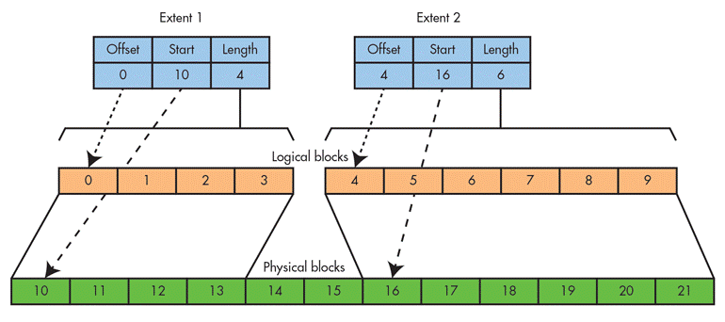
XFS Extents and Extent Lists
XFS divides the file system up into extents – sequences of blocks defined by a starting location and length
A file can have more than one extent if one chunk of contiguous disk space is not available for the file – if enough contiguous disk space is available, and extent could be potentially 8GB in length with a 4KB block size
Most of the time, an inode can’t store a whole file inside an extent inside itself, so instead will have an array of extents
inode
. . .
Notes:
http://xfs.org/docs/xfsdocs-xml-dev/XFS_Filesystem_Structure/tmp/en-US/html/Data_Extents.html

Slide 7
XFS B+Tree Extent Lists
XFS uses B+Trees to store longer lists of extents
The root node is stored in the inode
For a single level B+Tree, the root node points to the B+tree’s leaves
Each leaf contains a header (which includes links to its siblings), and an array of extents
For a multi-level B+tree, the root node points to other B+Tree nodes which eventually point to the leaves
Notes:
http://xfs.org/docs/xfsdocs-xml-dev/XFS_Filesystem_Structure/tmp/en-US/html/Btree_Extent_List.html

Slide 8
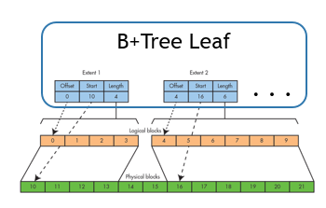
inode
Root of B+Tree
B+Tree Node
B+Tree Node
B+Tree Node
. . .
. . .

Slide 9
Linux File System Structure
Linux users all interact with files in the same way, regardless of the file system type
Everything starts at root - /
Different devices are mounted at different locations in the file system at mount point
You can use the df command to view the file systems and where they are mounted
We’ll cover the mount and umount commands later
Directories are a special type of file which contains a list of other files within it – which can in turn be directories (making them subdirectories)
You can use the du (disk usage) command to see how much space something is taking up

Slide 10
EXT4 filesystem
EXT started within Minix and was written in 1992
EXT2 was very popular in Linux distributions for many years
EXT3 introduced optimizations and also journaling
EXT4 improved performance, reliability, and capacity
Moved from allocating based on fixed blocks to extents of varying size (like in XFS)
EXT4 has superblocks which store similar information as in XFS
EXT4 divides the disk into block groups – much like XFS’ allocation groups
EXT4 also uses inodes
The basic function of the inode is identical to in XFS – the inode contains both the metadata and where to find the data for the file
Like in XFS, the inode does not contain the file name – instead, directories map filenames to inodes (all a directory is is a special file mapping filenames to inodes)
What differs from XFS is how the data is linked to – instead of using a B+ Tree, it uses a sequence of data pointers to extents

Slide 11
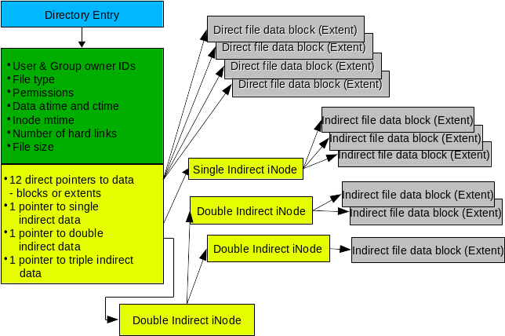
EXT4 inodes
Notes:
From https://opensource.com/article/17/5/introduction-ext4-filesystem

Slide 12
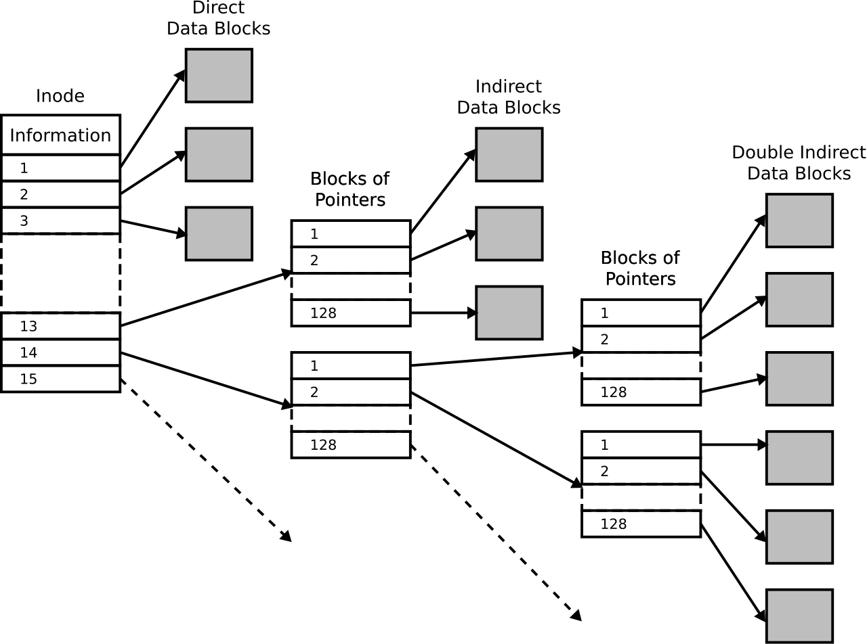
EXT4 Pointers
Notes:
From wikipedia

Slide 13
File System Hierarchy Standard
/ - Root directory of the entire file system
/bin - Essential binaries that need to be available to all
/boot - Boot loader files (kernel, etc)
/dev - Device files
/etc - System wide configuration files
/home - Standard location for users’ home directories
/lib - Essential libraries for binaries in /bin and /sbin
/media & /mnt - Mount points
/root - Home directory for root user
/sbin - Essential system binaries
/sys - Information about devices, drivers, etc
/usr - Most read-only user data
/var - Variable files – logs, mail, lock files, etc
There are other common directories, but these are the main ones a user might interact with.
Notes:
https://en.wikipedia.org/wiki/file system_Hierarchy_Standard

Slide 14
The Linux File system
“On a UNIX system, everything is a file; if something is not a file, it is a process”
Types of file (first character of ls –l):
- Regular files
d Directories
c Special files – used for input and output
l Links – Makes a file or directory visible in multiple parts of the file tree
s Domain sockets – providing inter-process networking
P Named pipes – Also allow processes to communicate with each other
Notes:
https://www.tldp.org/LDP/intro-linux/html/sect_03_01.html

